Slide 1
Moffat-Bay Lodge Team Bravo
Team: Andrew Bach, John Garcia, Somsak Bounchareune, Taylor Mommer, Torren Davis
Date: 04 October 2024

Slide 2
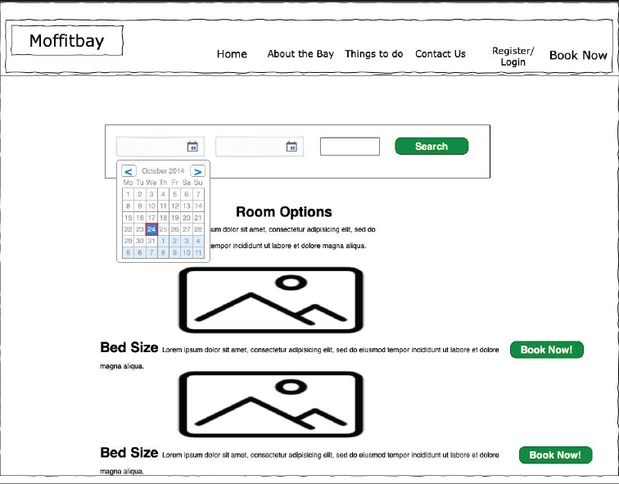
Sample Prototypes: Wireframe Examples

Slide 3
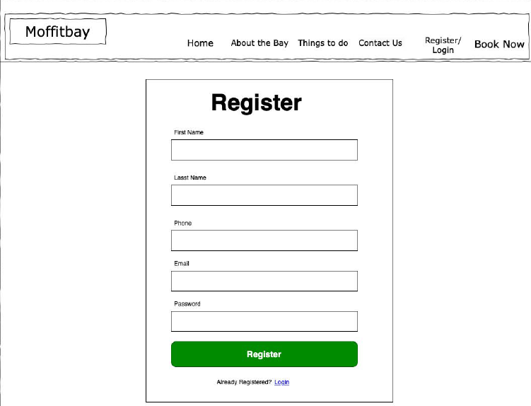
Sample Prototypes: Wireframe Examples

Slide 4
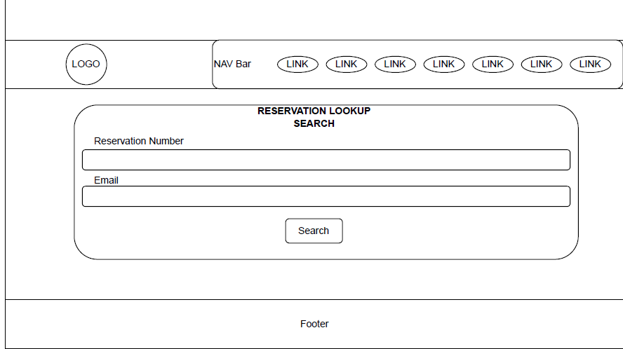
Sample Prototypes: Wireframe Examples

Slide 5
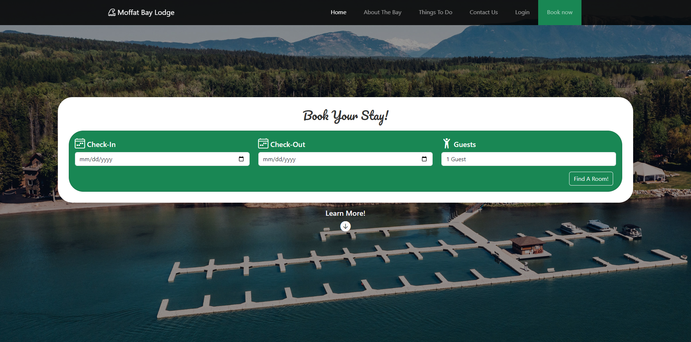
Landing Page Mockup

Slide 6
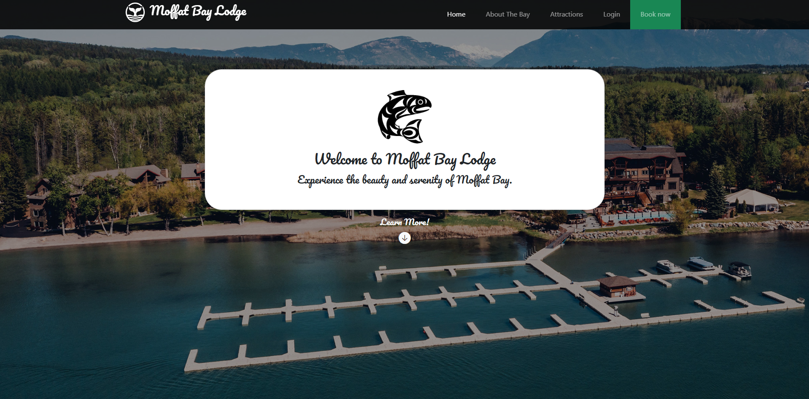
Final Design

Slide 7
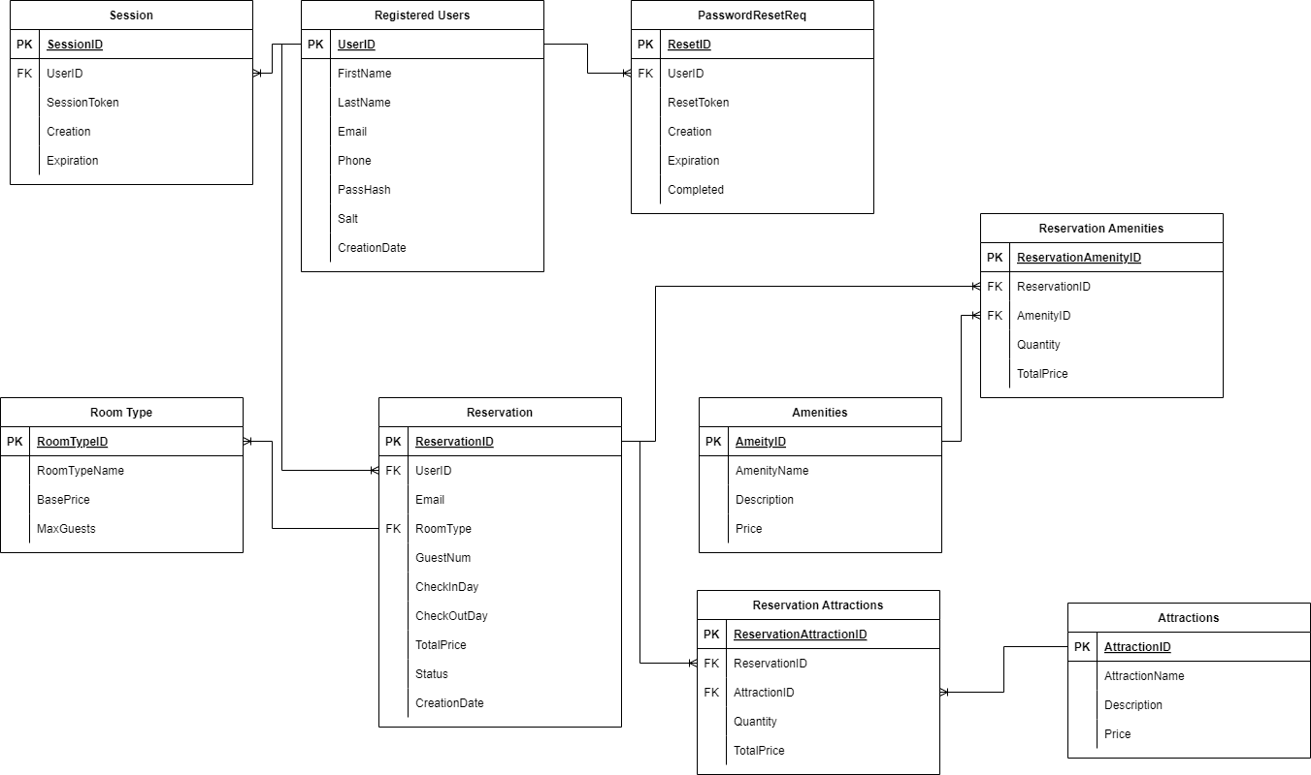
ERD

Slide 8
ERD Feedback changes
Removed the amenities table
Removed the reservation amenities table
Removed the attractions table
Removed the reservation attractions table
All changes above were made due to feedback from the “customer” because that was not requested in the project.
Removed password reset by choice as Django has this feature built in, and also it was not requested by the “customer”.

Slide 9
ERD Key Relationships
Session - Registered User; because this meant that there was a user logged into the session or not.
Reservation - Registered User; because this helps to keep reservations separated and tied to one user only.
Reservation - Room Type; because then we know what type of room the user has in the reservation and also know how much to charge them.

Slide 10
Tests Description and Results
Test 1: Landing Page load - Used to test if the landing page loads
Results: The landing page was loaded every time without error
Test 2: Successful User Registration - Used to test if users were made successfully
Results: Users were made successfully every time, except if the account creation did not meet requirements.
Test 3: Reservation Creation - Used to test if a reservation was able to be made
Results: Reservations were made successfully without error
Test 4: View Reservations - Used to test if a user is able to view all their reservations
Results: Users were able to view all reservations, regardless of who owned it, which was an error.
Test 5: Cancel Reservation - Used to test if a reservation was able to be canceled
Results: Reservations were able to be marked as canceled without error.

Slide 11
Lessons Learned - Team
The lesson I learned was that collaborating as a team efficiently and effectively, while all having different schedules, was hard; which was initially unexpected. -John
As a member of this team, I faced numerous challenges that mirrored real-world scenarios. Our biggest hurdle was coordinating across different time zones and schedules, which taught me valuable lessons in flexibility and communication. Learning Django pushed me out of my comfort zone, highlighting the importance of adaptability in tech. I navigated hardware issues and creative differences with my teammates, strengthening my problem-solving skills and teaching me to balance innovation with technical constraints. Ultimately, these challenges fostered my resilience and improved my remote collaboration abilities, preparing me for future professional environments. -Somsak
The lesson I learned was that working with varying schedules can make progress on the program difficult. However, as a team, we found it easier to communicate our availability each week. I also learned that working across different operating systems can complicate program development. I experienced several technical difficulties that sometimes hindered my ability to contribute fully. Thankfully, our team's communication was effective, which helped us navigate these challenges more smoothly. - Taylor

Slide 12
Lessons Learned - Team
This project taught me a valuable lesson in the challenges that come with working on a remote team, as each of us had our own schedules, complete with our own everyday tasks and routines, that played a part in when and how we could work on things as a whole. I feel that next time I enter a project like this, I will have a better grasp on my communications skills as well, as I did not like the initial feeling of being left in the dust, early on. All in all, I’ll do what I can to keep up with the team in the future. - Torren
For me, I think a big takeaway for me was just how important choosing the right tech stack is. If this was a long-term project, going with Django wouldn’t have been a big deal, but due to the pace at which we had to create the web site, I was unable to add certain features due to a lack of knowledge in Django and a lack of time to invest in learning more about Django. Moving forward, when deciding on which technology I plan to use, I will consider the time-frame I have to work on a project and if I can afford the time to learn it. - Andrew

Slide 13
Skills Developed/Improved
Communication and Collaboration
Coding with Python using Django
MySQL database connections with Django
Kanban Board usage

